Slide 1
Autonomous
Human-Robot
Interaction
Real-Time Face Tracking & Ultrasonic Spatial Mapping with OhBot
Python
OpenCV
YuNet
OhBot
ATmega32U4
Core idea
Presented by:
Sazzad Abdullah
Mahbub Ul Islam Khan
A robotic head that sees faces, moves naturally, senses nearby objects, and shows its perception on a radar map.
01

Slide 2
Project objective
What the system is built to do
Human detection
Natural motion
Object awareness
Recovery behavior
Detect faces using a camera and AI-based face detection.
Eyes handle small movements. The head moves when the face moves far from center.
Dual ultrasonic sensors detect nearby objects on the left and right side.
When the face is lost, the robot searches using ultrasonic direction cues.
Basic operating values
640 × 480
30 FPS
250 cm
2.5 s
8 frames
Camera resolution
Camera frame rate
Ultrasonic threshold
Face lost timeout
Position buffer
02

Slide 3
System architecture
Camera and sonar are processed together in Python
USB
Camera
OpenCV
Frame Input
YuNet / Haar
Face Detection
Tracking
Controller
OhBot
Servos
Left + Right
HC-SR04
ATmega32U4
Microcontroller
Serial JSON
115200 baud
Output: live camera HUD + radar map + servo motion
03

Slide 4
Face detection and tracking
How the robot decides where to look
Detect
face
Find center
Cx, Cy
Calculate
error
Smooth
movement
Move eyes
/head
Detector
Control zones
Stability values
Primary: YuNet
Fallback: Haar Cascade
Multi-face target: middle face
Eye-zone margin: 20%
Center area: eye only
Outer area: head + eyes
Head smoothing: 0.08
Eye smoothing: 0.20
Dead zone: 0.07
Design choice: eyes react faster, while the head stays smoother and less jerky.
04

Slide 5
When the face is lost
Vision first, ultrasonic recovery second
No face
detected
Wait
2.5 seconds
Read left/right
ultrasonic
Turn toward
closest side
Decision logic
Why this matters
Left distance smaller → turn left
Right distance smaller → turn right
No object under threshold → return to center
The robot keeps a basic sense of direction even when the camera temporarily loses the person.
2.5 s
< 250 cm
0.04
Lost timeout
Object threshold
Head return smoothing
05

Slide 6
LIVE DEMO
Walk in front of the robot. Watch it follow you.
06

Slide 7
Hardware values and servo limits
Important values used by the program
Head pan: 5.0
Head nod: 6.2
Eye pan: 5.0
Eye tilt: 5.0
Head pan: 1.0 to 9.0
Head nod: 5.2 to 7.5
Eye pan: 1.0 to 9.0
Eye tilt: 3.5 to 7.0
LEFT sensor
TRIG → Pin 9
ECHO → Pin 8
RIGHT sensor
TRIG → Pin 11
ECHO → Pin 10
Ultrasonic wiring
Neutral positions
Safe movement ranges
COM13
115200
250 cm
Serial port
Baud rate
Object threshold
07

Slide 8
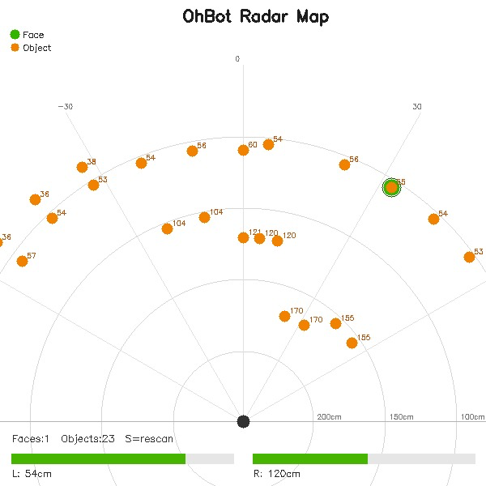
Environmental scan and radar
The robot maps faces and objects during scanning
Scan values
Radar values
Pan range: 2.0 to 8.0
Scan positions: 11
Settling delay: 0.55 s
Display size: 600 × 600 px
Range rings: 50, 100, 150, 200 cm
Green marker: face
Yellow marker: object
Duplicate handling
Nearby face detections are clustered if pan difference ≤ 2.0. This prevents one person from appearing as many people.
Radar view
08

Slide 9
Main improvements and conclusion
What the final code achieves
1. Serial communication fix
2. Scan stability
3. Mechanical compensation
4. Cleaner radar
DTR/RTS enabled for ATmega32U4 native USB streaming.
Servo settling delay and frame-buffer flushing reduce scan jitter.
Continuous nod hold prevents head sag from camera and sensor weight.
Detection clustering merges duplicate adjacent face sightings.
Final result
Computer vision + servo control + ultrasonic sensing + radar visualization
The OhBot can detect faces, track a target, sense nearby objects, recover after losing visual contact, and scan its surroundings.
Thank you
09

